Slide 2
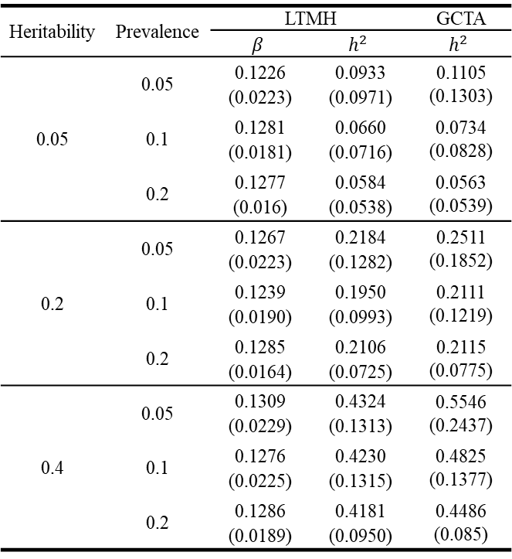
table 1
Heritability | Prevalence | LTMH |  | GCTA
 |  | $$β$$ | $$h^{2}$$ | $$h^{2}$$
0.05 | 0.05 | 0.1226 (0.0223) | 0.0933 (0.0971) | 0.1105 (0.1303)
 | 0.1 | 0.1281 (0.0181) | 0.0660 (0.0716) | 0.0734 (0.0828)
 | 0.2 | 0.1277 (0.016) | 0.0584 (0.0538) | 0.0563 (0.0539)
0.2 | 0.05 | 0.1267 (0.0223) | 0.2184 (0.1282) | 0.2511 (0.1852)
 | 0.1 | 0.1239 (0.0190) | 0.1950 (0.0993) | 0.2111 (0.1219)
 | 0.2 | 0.1285 (0.0164) | 0.2106 (0.0725) | 0.2115 (0.0775)
0.4 | 0.05 | 0.1309 (0.0229) | 0.4324 (0.1313) | 0.5546 (0.2437)
 | 0.1 | 0.1276 (0.0225) | 0.4230 (0.1315) | 0.4825 (0.1377)
 | 0.2 | 0.1286 (0.0189) | 0.4181 (0.0950) | 0.4486 (0.085)

Slide 3
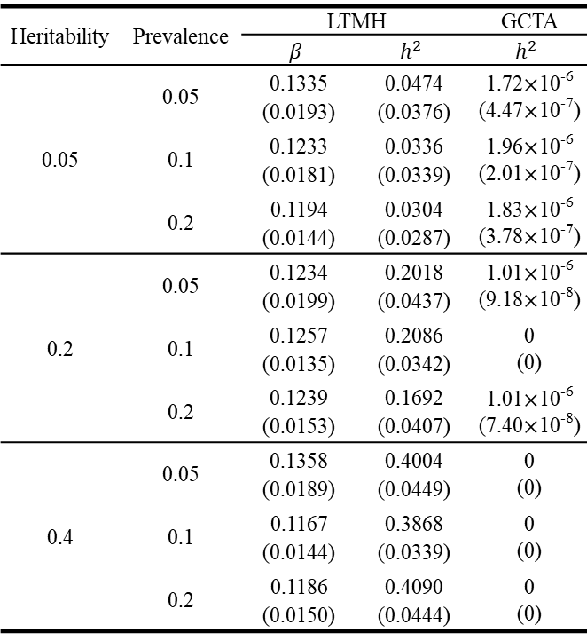
table 2
Heritability | Prevalence | LTMH |  | GCTA
 |  | $$β$$ | $$h^{2}$$ | $$h^{2}$$
0.05 | 0.05 | 0.1335 (0.0193) | 0.0474 (0.0376) | 1.72$×$10⁻⁶ (4.47$×$10⁻⁷)
 | 0.1 | 0.1233 (0.0181) | 0.0336 (0.0339) | 1.96$×$10⁻⁶ (2.01$×$10⁻⁷)
 | 0.2 | 0.1194 (0.0144) | 0.0304 (0.0287) | 1.83$×$10⁻⁶ (3.78$×$10⁻⁷)
0.2 | 0.05 | 0.1234 (0.0199) | 0.2018 (0.0437) | 1.01$×$10⁻⁶ (9.18$×$10⁻⁸)
 | 0.1 | 0.1257 (0.0135) | 0.2086 (0.0342) | 0 (0)
 | 0.2 | 0.1239 (0.0153) | 0.1692 (0.0407) | 1.01$×$10⁻⁶ (7.40$×$10⁻⁸)
0.4 | 0.05 | 0.1358 (0.0189) | 0.4004 (0.0449) | 0 (0)
 | 0.1 | 0.1167 (0.0144) | 0.3868 (0.0339) | 0 (0)
 | 0.2 | 0.1186 (0.0150) | 0.4090 (0.0444) | 0 (0)

Slide 4
table 3
Heritability | Prevalence | Significance level
 |  | 0.01 | 0.05 | 0.1
0 | 0.05 | 0.0015 | 0.0115 | 0.0285
 | 0.1 | 0.0050 | 0.0480 | 0.1020
 | 0.2 | 0.0015 | 0.0200 | 0.0505
0.2 | 0.05 | 0.0485 | 0.2260 | 0.3990
 | 0.1 | 0.3420 | 0.6730 | 0.8055
 | 0.2 | 0.6210 | 0.8675 | 0.9405
0.4 | 0.05 | 0.4575 | 0.8190 | 0.9050
 | 0.1 | 0.9395 | 0.9930 | 0.9960
 | 0.2 | 1.0000 | 1.0000 | 1.0000

Slide 5
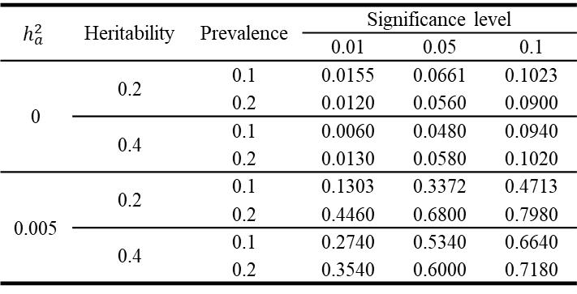
table 4
$$h_{a}^{2}$$ | Heritability | Prevalence | Significance level
 |  |  | 0.01 | 0.05 | 0.1
0 | 0.2 | 0.1 | 0.0155 | 0.0661 | 0.1023
 |  | 0.2 | 0.0120 | 0.0560 | 0.0900
 | 0.4 | 0.1 | 0.0060 | 0.0480 | 0.0940
 |  | 0.2 | 0.0130 | 0.0580 | 0.1020
0.005 | 0.2 | 0.1 | 0.1303 | 0.3372 | 0.4713
 |  | 0.2 | 0.4460 | 0.6800 | 0.7980
 | 0.4 | 0.1 | 0.2740 | 0.5340 | 0.6640
 |  | 0.2 | 0.3540 | 0.6000 | 0.7180

Slide 6
table 5
Heritability | Prevalence | Significance level
 |  | 0.01 | 0.05 | 0.1
0 | 0.05 | 0.0000 | 0.0025 | 0.0100
 | 0.1 | 0.0005 | 0.0045 | 0.0095
 | 0.2 | 0.0000 | 0.0075 | 0.0215
0.2 | 0.05 | 0.4735 | 0.8110 | 0.9185
 | 0.1 | 0.8520 | 0.9660 | 0.9850
 | 0.2 | 0.8155 | 0.9540 | 0.9855
0.4 | 0.05 | 1.0000 | 1.0000 | 1.0000
 | 0.1 | 1.0000 | 1.0000 | 1.0000
 | 0.2 | 1.0000 | 1.0000 | 1.0000

Slide 7
table 7
 | Proband | Non-proband
Disease status
T2D | 648 (100%) | 1,115 (26.87%)
Normal | 0 (0%) | 3,034 (73.13%)
Sex
Male | 308 (47.53%) | 2,058 (49.6%)
Female | 340 (52.47%) | 2,091 (50.4%)
Age | 55.44 (10.7) | 47.56 (16.09)
Relationship of relatives with proband
Parents |  | 329 (7.93%)
Sibling |  | 2,457 (59.22%)
Offspring |  | 1,363 (32.85%)

Slide 8
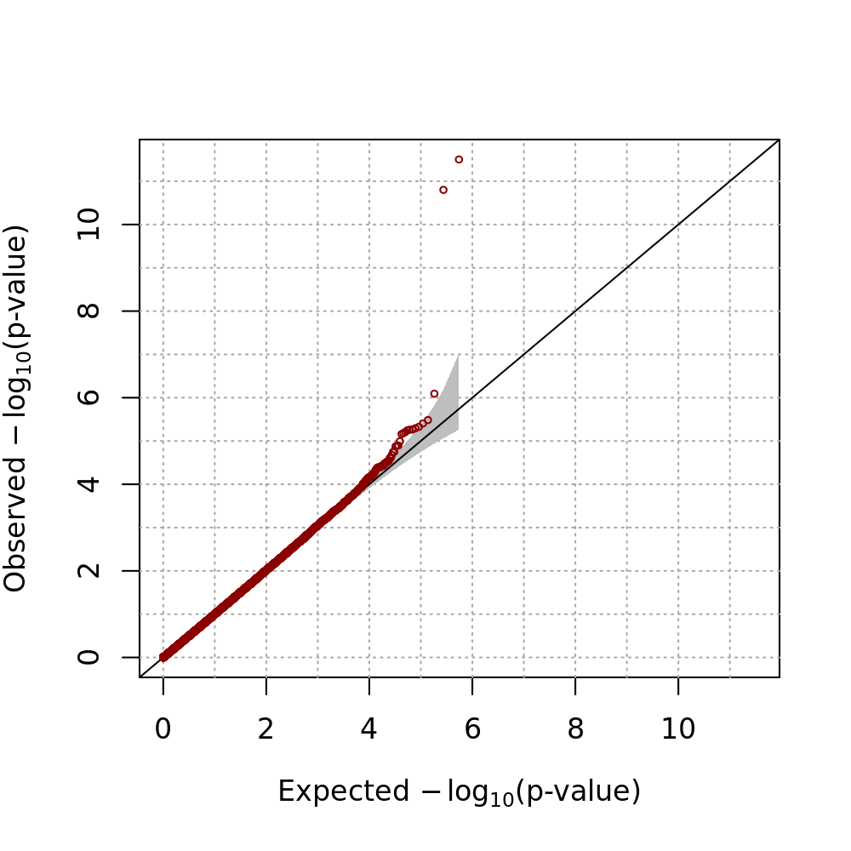
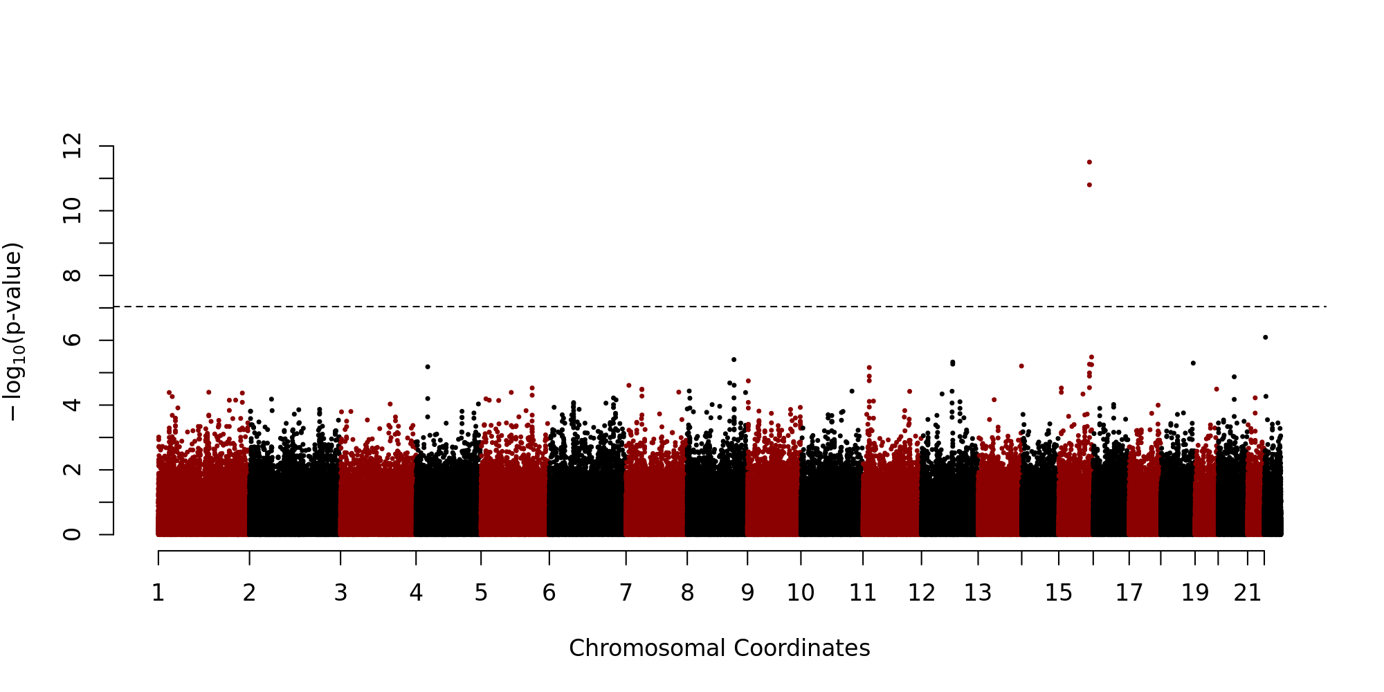
a)
b)

Slide 9
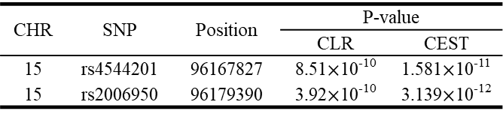
CHR | SNP | Position | P-value
 |  |  | CLR | CEST
15 | rs4544201 | 96167827 | 8.51$×$10⁻¹⁰ | 1.581$×$10⁻¹¹
15 | rs2006950 | 96179390 | 3.92$×$10⁻¹⁰ | 3.139$×$10⁻¹²

